Slide 1
Web 2.0
V.Mareeswari
Assistant Professor
School of Information Technology & Engineering
VIT University, Vellore

Slide 2
Web 2.0
One way to look at Web 1.0 (1990s and early 2000s) is as a lecture, a small number of professors informing a large audience of students. In comparison, Web 2.0 is a conversation, with everyone having the opportunity to speak and share views.
Generally, Web 2.0 companies use the web as a platform to create collaborative, community-based sites (e.g., social networking sites, blogs, wikis, etc.).
For websites like MySpace, Facebook, Flickr,YouTube, eBay and Wikipedia, users create the content, while the companies provide the platforms. These companies trust their users—without such trust, users cannot make significant contributions to the sites.
“We can’t be device centric...we must be user centric.” —Bill Gates
Web 1.0 servers sent mostly static web pages coded in HTML or XHTML to browsers that rendered the pages on the screen. Web 2.0 applications are more dynamic, generally enabling significant interaction between the user (the client) and the computer (the server), and among communities of users.

Slide 3
Search Engines
InWeb 2.0, the saying “content is king” remains a prevailing theme.
“Google’s mission is to organize the world’s information and make it universally accessible and useful.” —Google
The comScore (a web analytics company) analysis of U.S. market share across the most popular search engines reported Google at the top with 49.5% of the U.S. search market, followed by Yahoo! with 25.1%,Microsoft with 13.2%, Ask with 5.0% and Time Warner Network with 4.2%.

Slide 4
Content networks
Content networks are websites or collections of websites that provide information in various forms (such as articles, wikis, blogs, etc.).
These provide another way of filtering the vast amounts of information on the Internet, by allowing users to go to a trusted site that has already sorted through many sources to find the best content or has provided its own content.
Eg: About.com, Deitel, eHow, HowStuffWorks, LifeTips, Weblogs, Inc.

Slide 5
User-generated content
User-generated content has been the key to success for many of today’s leading Web 2.0 companies.
For example, eBay (an online auction site) relies on the community to buy and sell auction items, and Monster (a job search engine) connects job seekers with employers and recruiters.
For example, every product you buy from Amazon and every video you watch on YouTube provides these sites with valuable information about your interests.

Slide 6
Collective intelligence
Collective intelligence is the concept that collaboration can result in smart ideas. Working together, users combine their knowledge for everyone’s benefit.
Eg: Reputation systems (used by companies like eBay) also use collective intelligence to build trust between buyers and sellers by sharing user feedback with the community.

Slide 7
Wikis
Wikis, websites that allow users to edit existing content and add new information, are prime examples of user-generated content and collective intelligence.
The most popular wiki is Wikipedia, a community-generated encyclopedia with articles available in over 200 languages.
Wikipedia trusts its users to follow certain rules, such as not deleting accurate information and not adding biased information, while allowing community members to enforce the rules.
The software can be downloaded from MediaWiki’s website (www.mediawiki.org), where you can also find descriptions, tutorials, suggestions and more to help navigate the software.
Wikia - a site for specialized wiki communities about popular television shows, games, literature, shopping and more.

Slide 8
Collaborative Filtering
Though collaboration can result in a wealth of knowledge, some users might submit false or faulty information.
This collaborative filtering lets users promote valuable material and flag offensive or inappropriate material. Users have the power to choose for themselves what is important.
Examples of sites using collaborative filtering include
Digg, a news site where users rate the stories,
social bookmarking sites such as del.icio.us, where users can easily find popular sites .
Customer reviews on Amazon products also employ collaborative filtering— readers vote on the usefulness of each review (helping other readers to find the best reviews).

Slide 9
Craigslist
Craigslist, founded by Craig Newmark, is a popular classified ads website that has radically changed the classified advertising market.
Most ad postings on Craigslist are free, and it’s easy for anyone to post ads.
The site also uses collaborative filtering—users are encouraged to flag inappropriate postings.

Slide 10
Blogging
The term “blog” evolved from weblog, a regularly updated list of interesting websites.
These blogs consisted of short postings, in reverse chronological order, that contained links to other web pages and short commentaries or reactions.
The number of blogs has been doubling about twice a year.
Increased use of mobile devices has also lead to moblogging, or mobile blogging, as bloggers no longer need to be at their computer to update their blogs.
Similarly, vlogging, or video blogging, has gained popularity. Rocketboom, for example, posts a three-minute video every day covering news and Internet stories.
Companies are reaching out to the blogosphere, or blogging community, to keep in touch with consumer opinions.
Online hosted blog software options include WordPress , TypePad and Blogger. WordPress is a free and open source blogging tool and a content management system based on PHP and MySQL.

Slide 11
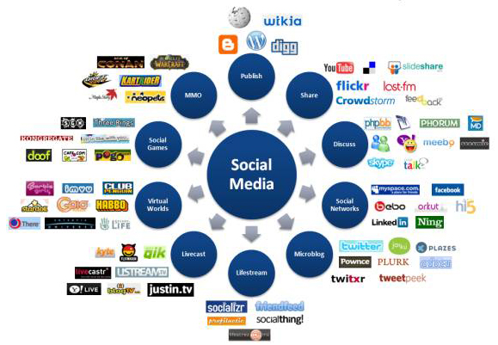

Slide 12
Social Networking
Social networking sites, which allow users to keep track of their existing interpersonal relationships and form new ones, are experiencing extraordinary growth in Web 2.0.
Eg:
Friendster
MySpace
Facebook
LinkedIn
Xing
Second Life
Twitter

Slide 13
Social Media
Social media refers to any media shared online (e.g., videos, music, photos, news, etc.).
Eg:
YouTube - In true Web 2.0 fashion, the entire site is based on user-generated content.
Internet TV - Sites, such as Joost, Veoh and MobiTV, have emerged as a new way of watching television.
Last.fm is an Internet radio website that uses Web 2.0 concepts to make music recommendations and build communities.

Slide 14
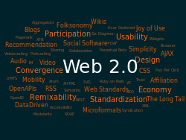
Tagging
Tagging, or labeling content, is part of the collaborative nature of Web 2.0. A tag is any user-generated word or phrase that helps organize web content and label it in a more human way.
Flickr is a key content-tagging site. Intended as a way of organizing personal photo collections, tagging on the site gained popularity as the community became interested in “a global view of the tagscape” (how other people are tagging photos). You can assign up to 75 tags to each photo or video.

Slide 15
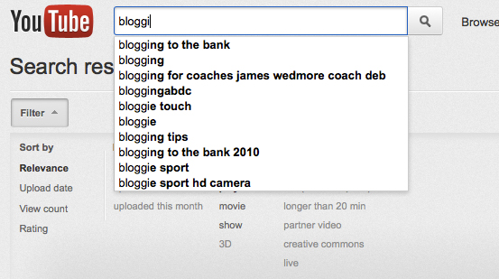
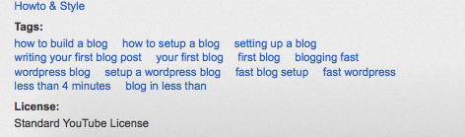
YouTube is the most popular video site on the Internet. It receives millions of visitors every year. These people visit to look at some interesting videos. Uploading your video there will make it possible for it to be seen by millions of people. But, with so many other videos out there, you need to work hard to make sure yours stands out from the crowd.
Tags are also known as keywords, and this is one great way to make your videos easier to find. By assigning tags, it should be much easier for people to search and find your videos by searching for various keyword phrases in YouTube.

Slide 16
Social bookmarking
Social bookmarking sites let you share your Internet bookmarks (e.g., your favorite websites, blogs, and articles) through a website.
Users can access these bookmarks from any computer and discover new sites by searching popular bookmarks and tags.
Some of the most popular social bookmarking sites are del.icio.us, Ma.gnolia, Blue Dot, Stumble-Upon, Simpy and Furl.

Slide 17
Software Development
A key to Web 2.0 software development is to KIS (keep it simple; keep it small).
The Webtop or web desktop, allows you to run web applications in a desktop-like environment in a web browser.
Eg: Laszlo Webtop, eyeOS and StartForce
Software as a Service (SaaS), application software that runs on a web server rather than being installed on the client computer, has gained popularity, particularly with businesses.
Eg: Most Google software is offered as SaaS. Microsoft now offers SaaS products, Windows Live and Office Live.

Slide 18
Web Service
Web services have emerged and, in the process, have inspired the creation of many Web 2.0 businesses.
Web services allow you to incorporate functionality from existing applications and websites into your own web applications quickly and easily.
Eg: using Google™ Maps web services with eBay web services, you can build location-based “mashup” applications to find auction items in certain geographical areas.

Slide 19
Semantic Web
“The Holy Grail for developers of the semantic Web is to build a system that can give a reasonable and complete response to a simple question like: I’m looking for a warm place to vacation and I have a budget of $3,000. Oh, and I have an 11- year-old child… Under Web 3.0, the same search would ideally call up a complete vacation package that was planned as meticulously as if it had been assembled by a human travel agent.” —John Markoff
Though Web 2.0 applications are finding meaning in content, the Semantic Web will attempt to make those meanings clear to computers as well as humans.
Realization of the Semantic Web depends heavily on XML and XML-based technologies, which help make web content more understandable to computers.

